Slide 1
VAE with Gaussian Mixture for clustering
Project work in Artificial Intelligence in industry
Gaetano signorelli

Slide 2
Brief recap
Problem: clustering the repertoire of nightingales’ songs
Encoding: Mel-Spectrograms
Implementation of 3 different models combined with different clustering techniques
Interesting results with the main architecture (NSCNet)
Zipf’s law hypothesis on the distribution of the clusters

Slide 3
VAE’s issue
One of the main models combined a VAE, to reduce dimensionality, with a clustering algorithm
Implementation of a vanilla VAE
Better than a standard Autoencoder (rearrangement of the latent space)
Low silhouette score on VAE’s Gaussian distribution
Tendency to compress all the samples into a single cluster around the mean of the Gaussian
Bad results on all tested clustering methods

Slide 4
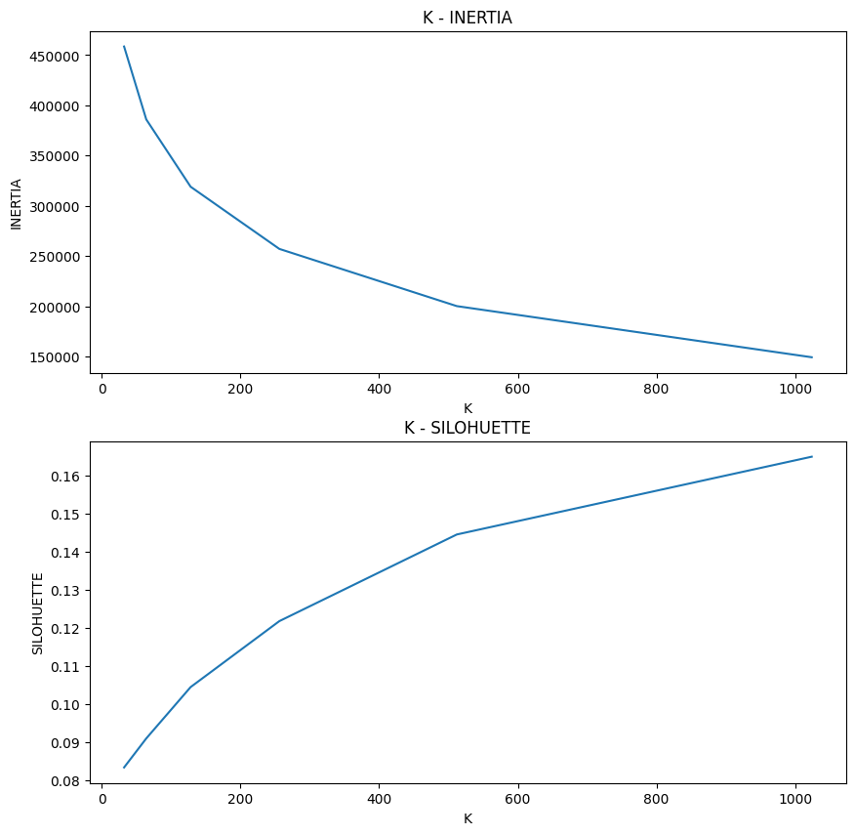
First test – VAE without regularization
Removed the Kullback-Leibler divergence term
Approximation of an Autoencoder
Better results, but still not good overall (much below NSCNet)

Slide 5
Variational Deep Embedding (VaDE)
Implementation of a new architecture (variation of VAE)
Optimized projection to latent space for clustering
Adopted in many clustering problems in recent years
Flexible and with many advantages

Slide 6
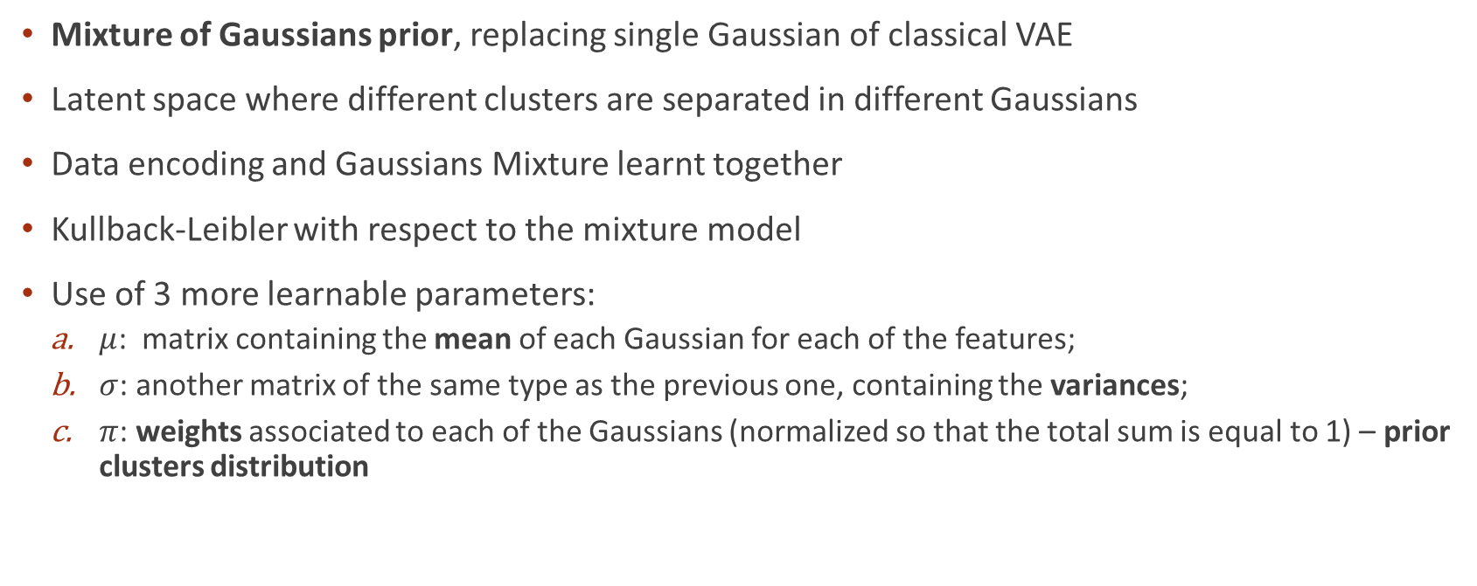
VaDE – Theoretical idea
Mixture of Gaussians prior, replacing single Gaussian of classical VAE
Latent space where different clusters are separated in different Gaussians
Data encoding and Gaussians Mixture learnt together
Kullback-Leibler with respect to the mixture model
Use of 3 more learnable parameters:
$μ$: matrix containing the mean of each Gaussian for each of the features;
$σ$: another matrix of the same type as the previous one, containing the variances;
$π$: weights associated to each of the Gaussians (normalized so that the total sum is equal to 1) – prior clusters distribution

Slide 7
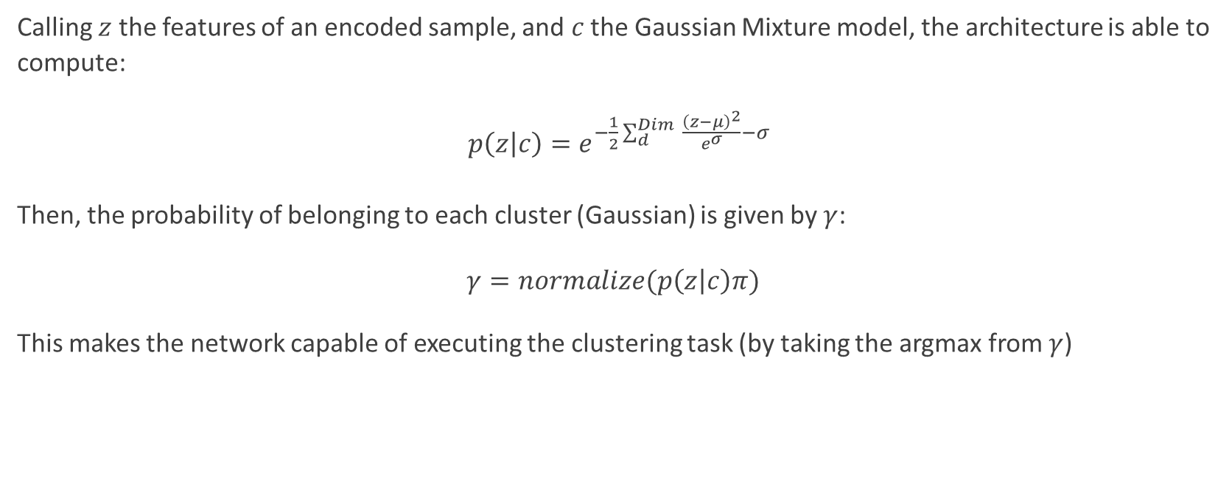
VaDE – Theoretical idea
Calling $z$ the features of an encoded sample, and $c$ the Gaussian Mixture model, the architecture is able to compute:
$p\left(z | c\right)=e^{−\frac{1}{2}\sum_{d}^{Dim}{ \frac{{\left(z−μ\right)}^{2}}{e^{σ}}}−σ}$
Then, the probability of belonging to each cluster (Gaussian) is given by $γ$:
$γ=normalize(p\left(z | c\right)π)$
This makes the network capable of executing the clustering task (by taking the argmax from $γ$)

Slide 8
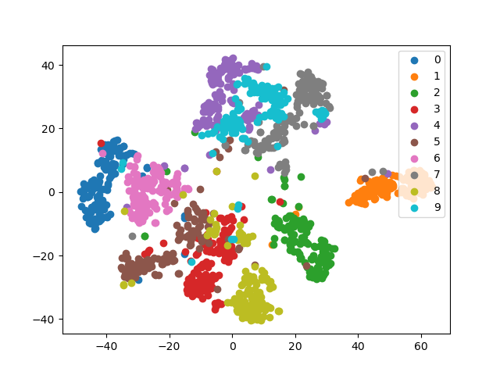
VaDE – Results on MNIST
Results described on the original paper have been replicated, to test the implementation and the reliability of the network, using the popular MNIST dataset

Slide 9
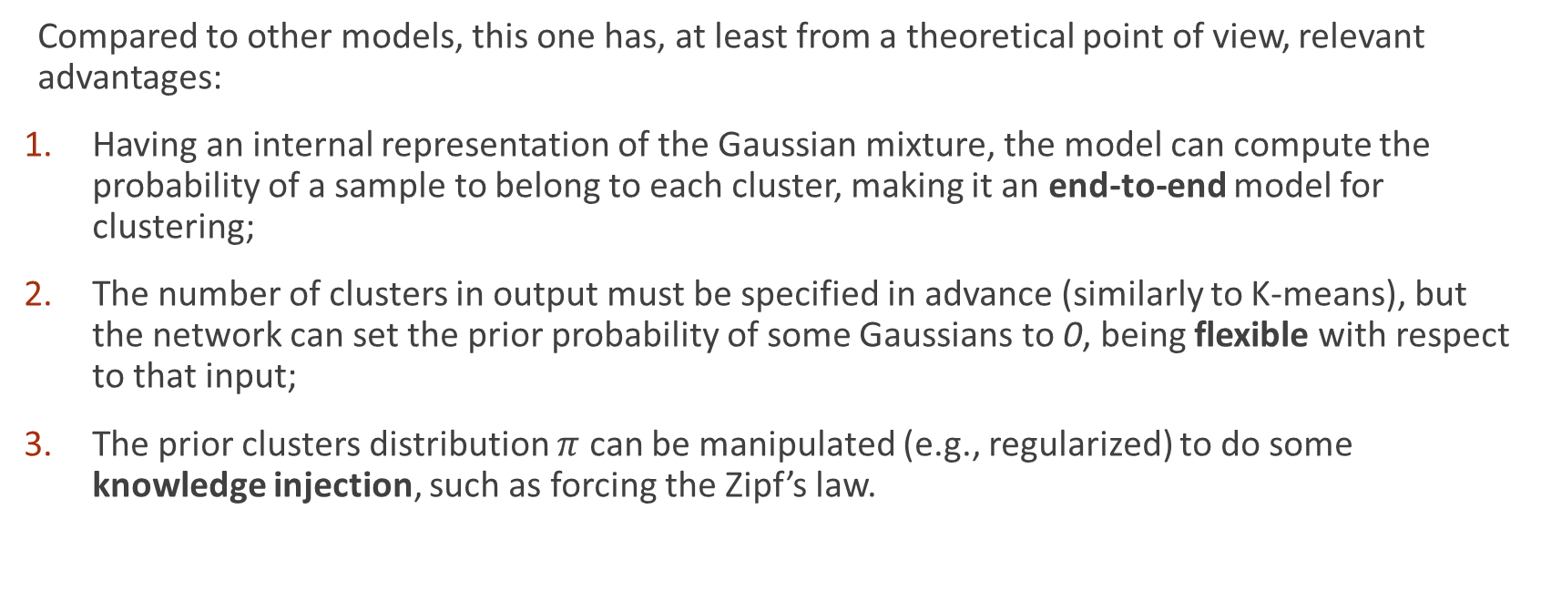
VaDE – Advantages
Compared to other models, this one has, at least from a theoretical point of view, relevant advantages:
Having an internal representation of the Gaussian mixture, the model can compute the probability of a sample to belong to each cluster, making it an end-to-end model for clustering;
The number of clusters in output must be specified in advance (similarly to K-means), but the network can set the prior probability of some Gaussians to 0, being flexible with respect to that input;
The prior clusters distribution $π$ can be manipulated (e.g., regularized) to do some knowledge injection, such as forcing the Zipf’s law.

Slide 10
Trivial parametrization
Instability of the model increasing (compared to MNIST test) the number of Gaussians (expected clusters) and latent space dimensions
Trivial parametrization of the network to reduce both reconstruction loss and KL loss
High unbalance in prior distribution toward a single Gaussian
Reduction to original vanilla VAE
Bad organized space and low scores

Slide 11
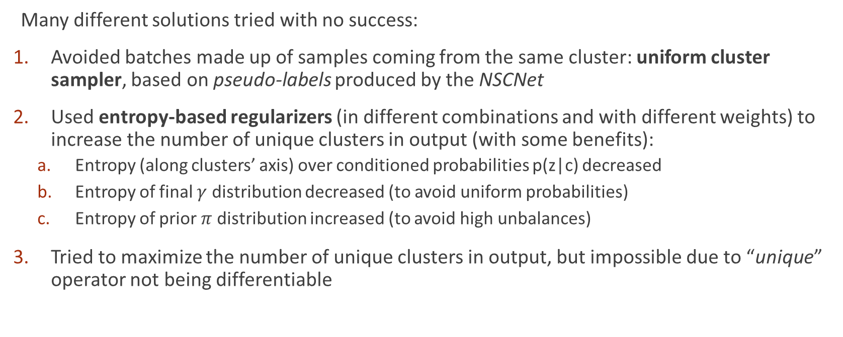
Trivial parametrization
Many different solutions tried with no success:
Avoided batches made up of samples coming from the same cluster: uniform cluster sampler, based on pseudo-labels produced by the NSCNet
Used entropy-based regularizers (in different combinations and with different weights) to increase the number of unique clusters in output (with some benefits):
Entropy (along clusters’ axis) over conditioned probabilities p(z|c) decreased
Entropy of final $γ$ distribution decreased (to avoid uniform probabilities)
Entropy of prior $π$ distribution increased (to avoid high unbalances)
Tried to maximize the number of unique clusters in output, but impossible due to “unique” operator not being differentiable

Slide 12
Failures interpretation
By increasing the number of features (from 32 on), conditioned probabilities start to become uniform (same probability to belong to each of the Gaussians)
Curse of dimensionality
Increasing the number of expected clusters reduce the number of unique clusters in output
Higher complexity
Converging issues
Trivial parametrization
Few clusters (Gaussians) dominating
Huge scalability issues

Slide 13
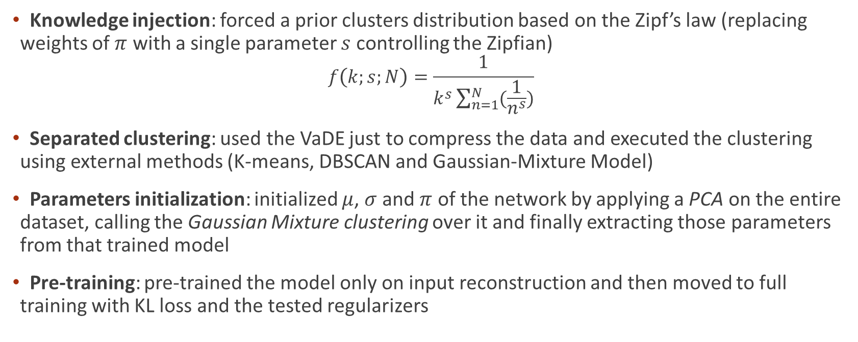
Other attempts
Knowledge injection: forced a prior clusters distribution based on the Zipf’s law (replacing weights of $π$ with a single parameter $s$ controlling the Zipfian)
$$f\left(k;s;N\right)=\frac{1}{k^{s}\sum_{n=1}^{N}{(\frac{1}{n^{s}})}}$$
Separated clustering: used the VaDE just to compress the data and executed the clustering using external methods (K-means, DBSCAN and Gaussian-Mixture Model)
Parameters initialization: initialized $μ$, $σ$ and $π$ of the network by applying a PCA on the entire dataset, calling the Gaussian Mixture clustering over it and finally extracting those parameters from that trained model
Pre-training: pre-trained the model only on input reconstruction and then moved to full training with KL loss and the tested regularizers

Slide 14
Conclusions
Inability to use VaDE as an end-to-end model (due to trivial parametrization)
Unsatisfactory results, similar to VAE’s ones, with VaDE followed by a clustering algorithm (bad latent space organization due to trivial parametrization, again)
Scalability issues have emerged
Interesting key points for an improved model:
Possibility of injecting knowledge
Flexibility in the number of clusters returned by the model
Autoencoder-like architecture used to cluster (end-to-end approach)

